Slide 1
Finding links between Raga and Rasa: a musicological study
Rhythm Jain & Dhruv Pargai
Dec 5, 2022

Slide 2
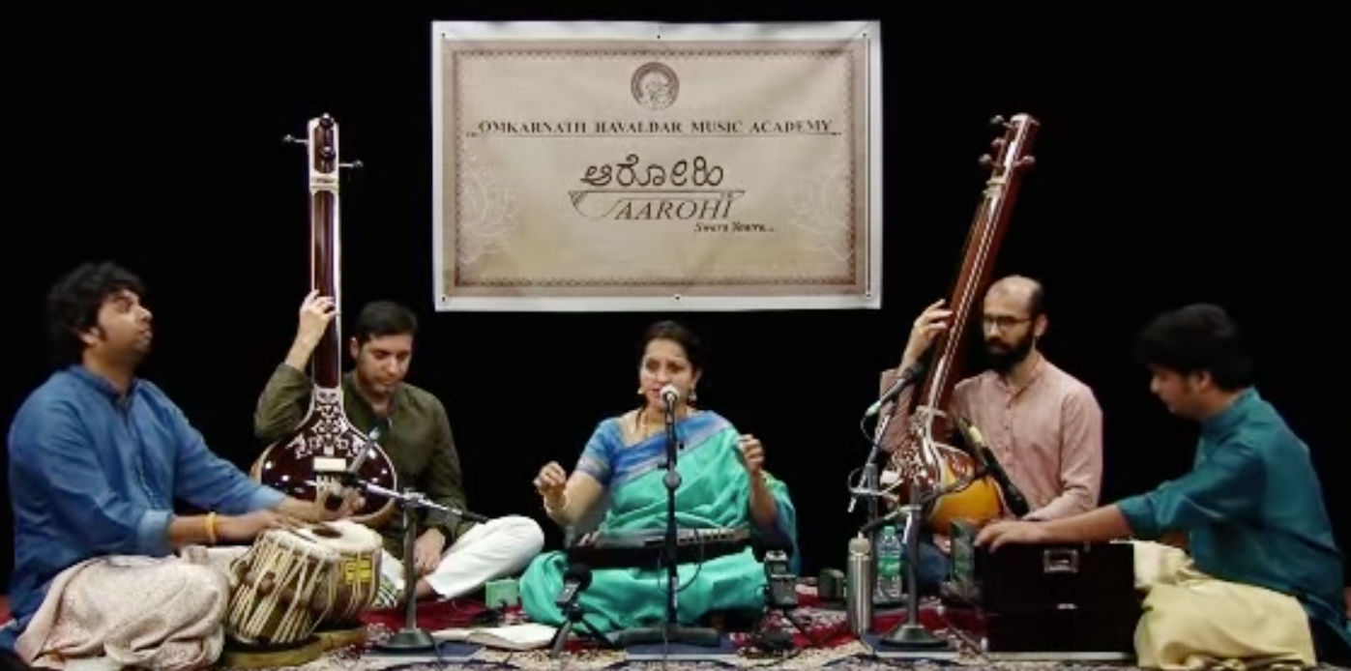
Motivation
RAGA: Melodic framework for improvisation
RASA: Emotion conveyed by the raga
“A performer conveys an emotion through the vessel of a raga to induce that emotion in the listener.”
Notes:
Define Raga and Rasa here
Raga: notes, note-to-note, ornamentation: hit notes a certain way, grammar,

Slide 3
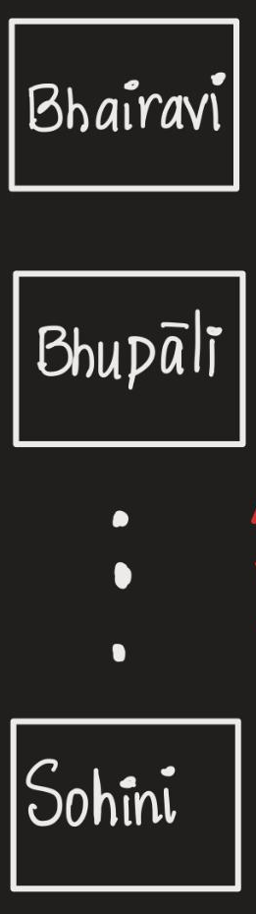
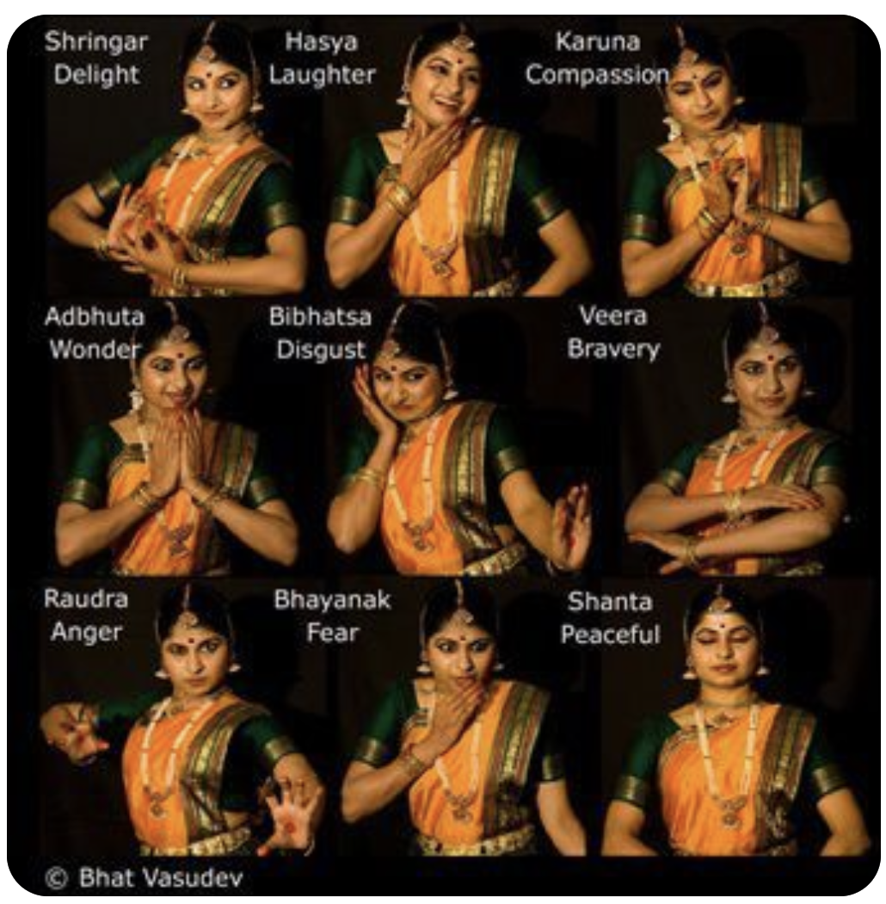
Motivation
RAGA
RASA
Many to many map between rāga and rasa.
Image credits: bharathgyanblog.wordpress.com
Notes:
Earliest hints at linking art -> emotion
Today, evolved into Raga-> Rasas

Slide 4
Alternative Hypotheses H₁
Ragas belonging to the same rasa have similar melodic structures.

Slide 5
Null Hypotheses H₀
Ragas belonging to the same rasa do not have similar melodic structures. There are no melodic similarities between ragas in the same rasas.

Slide 6
Operationalization
Similar melodic structures :
1 gram (swara count),
2-gram, 3-gram

Slide 7
Analysis Plan
Corpus Preprocessing
Conversion into swara (1,2,3 – gram) tallies
Intra-Rasa
(Wasserstein Distance)
Inter-Rasa comparison (Welsch T test)
Notes:
Due to the very time consuming process of manual transcriptions and scarce data available in HCM, we decided to pick an existing dataset, so Convenience sampling

Slide 8
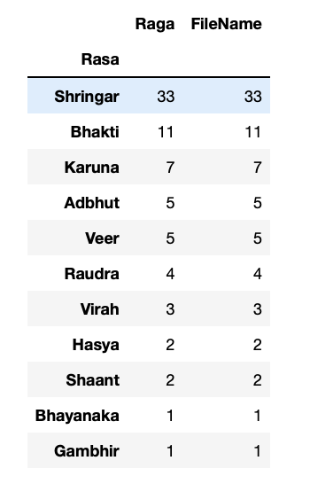




Preprocessing
Final Tallies
Rasa | Ragas
Shringar | 33
Bhakti | 13
Karuna | 10
Adbhut | 5
Veer | 5

Slide 9
Preprocessing
The metric is the minimum "cost" of turning one pile into the other, which is assumed to be the amount of earth that needs to be moved times the mean distance it has to be moved.
Wasserstein Distance
(earth mover distance)
Notes:
Inter-rasa comparison

Slide 10
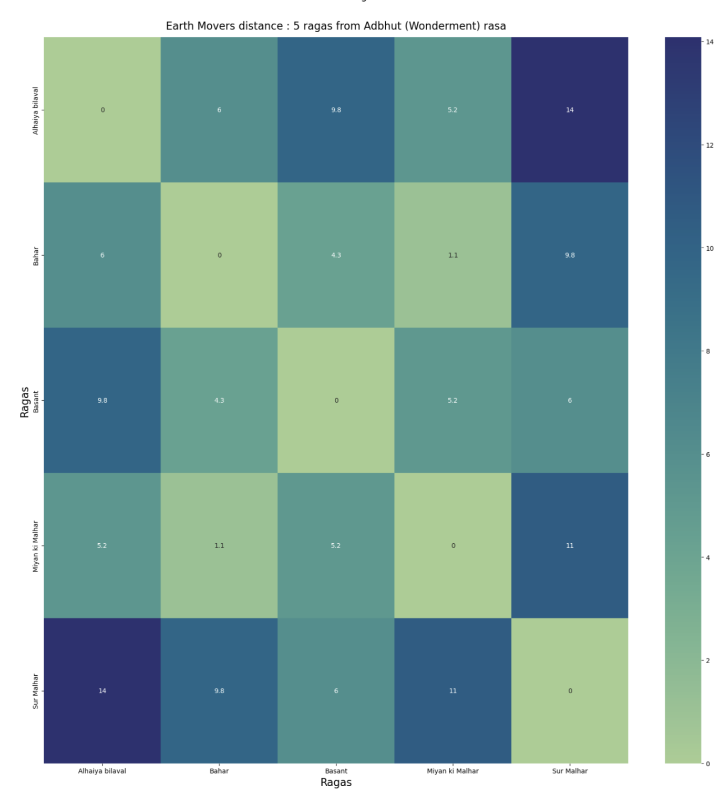
Adbhut (Wonderment)
Notes:
After that we get note counts, and between each pair of ragas. Each raga is 12 dimensional vector of a raga, we calculate a distance. Metric we chose is the earth mover’s distance.

Slide 11
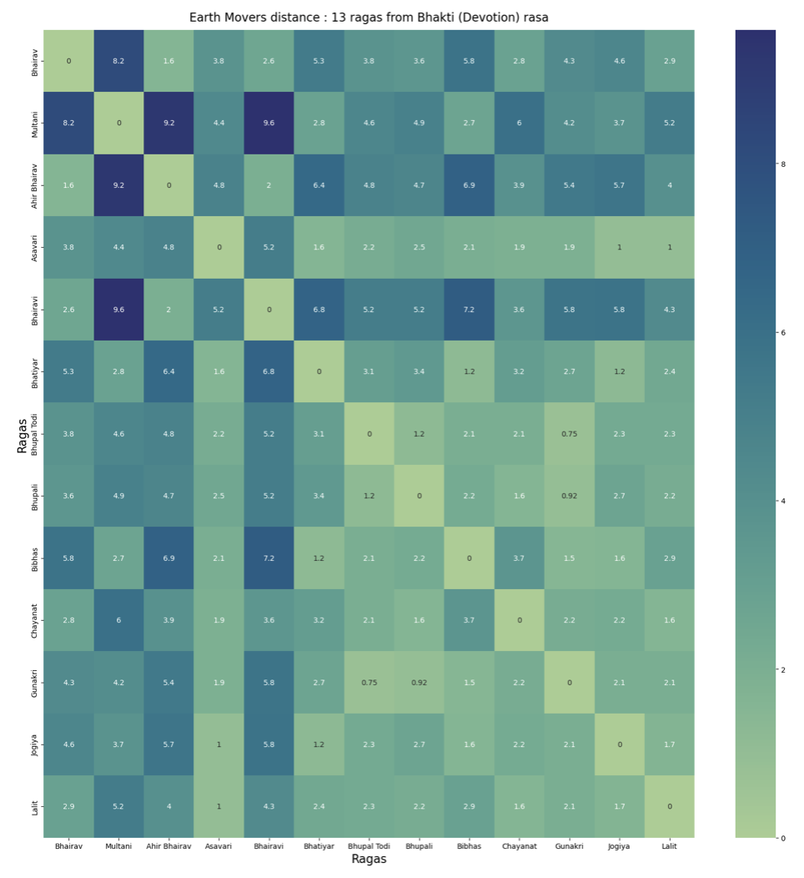
Bhakti (Devotion, Peace)
Notes:
Jaijaivanti really dissimilar

Slide 12
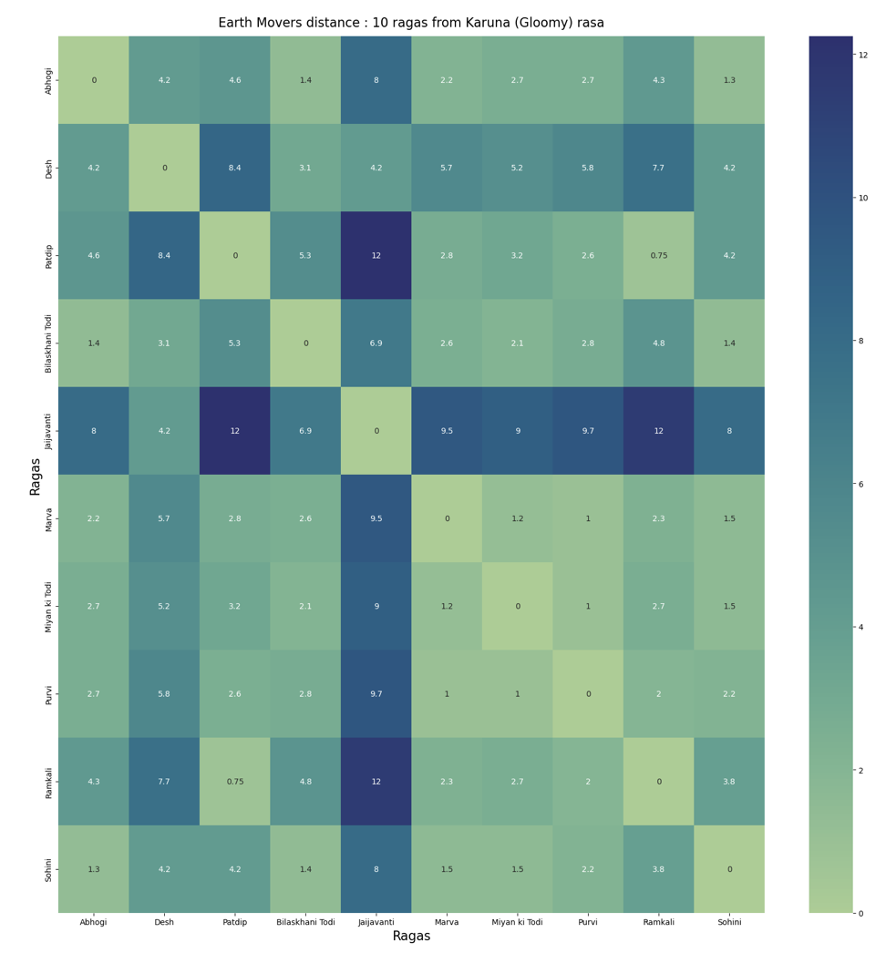
Karuna (Sadness)
Notes:
Jaijaivanti really dissimilar

Slide 13
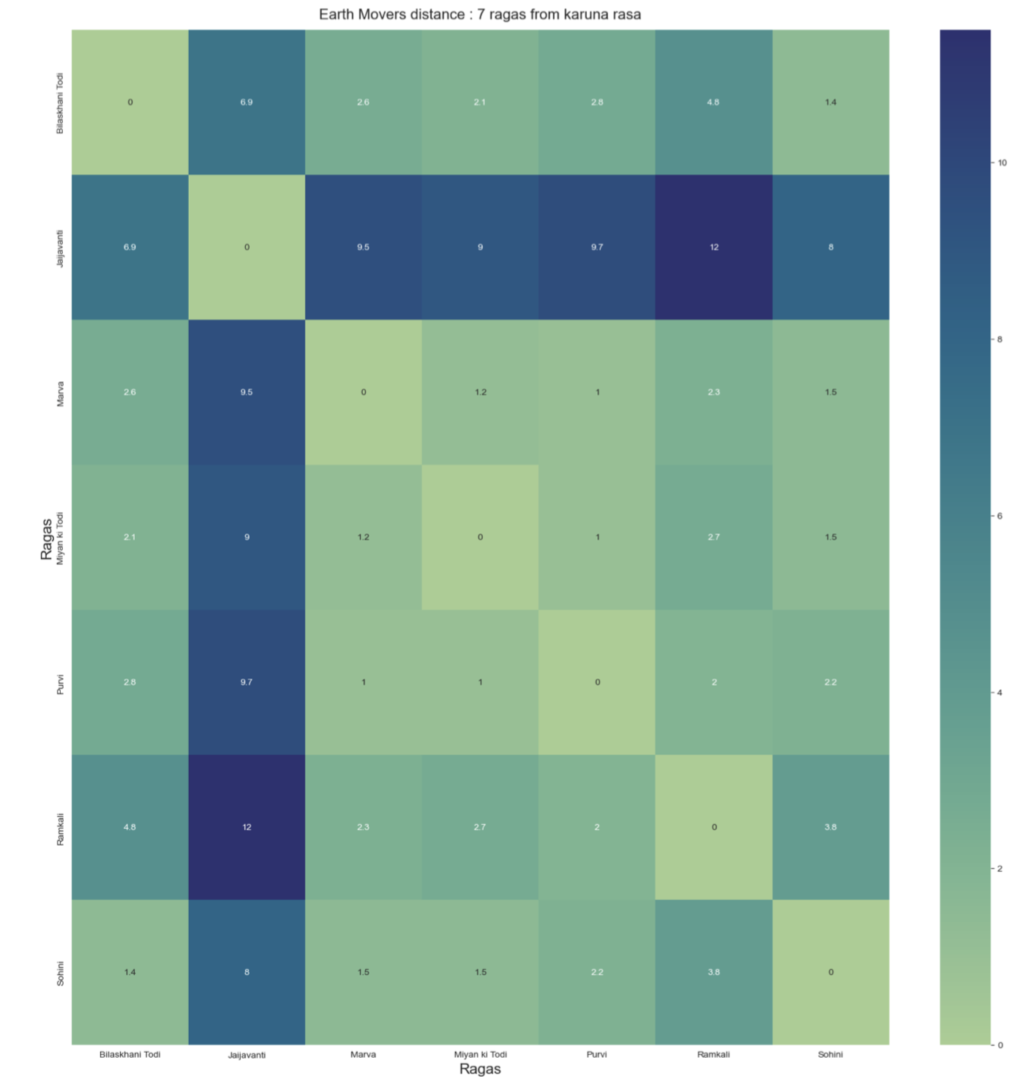
Karuna (Compassion, sadness)
Notes:
Jaijaivanti really dissimilar

Slide 14
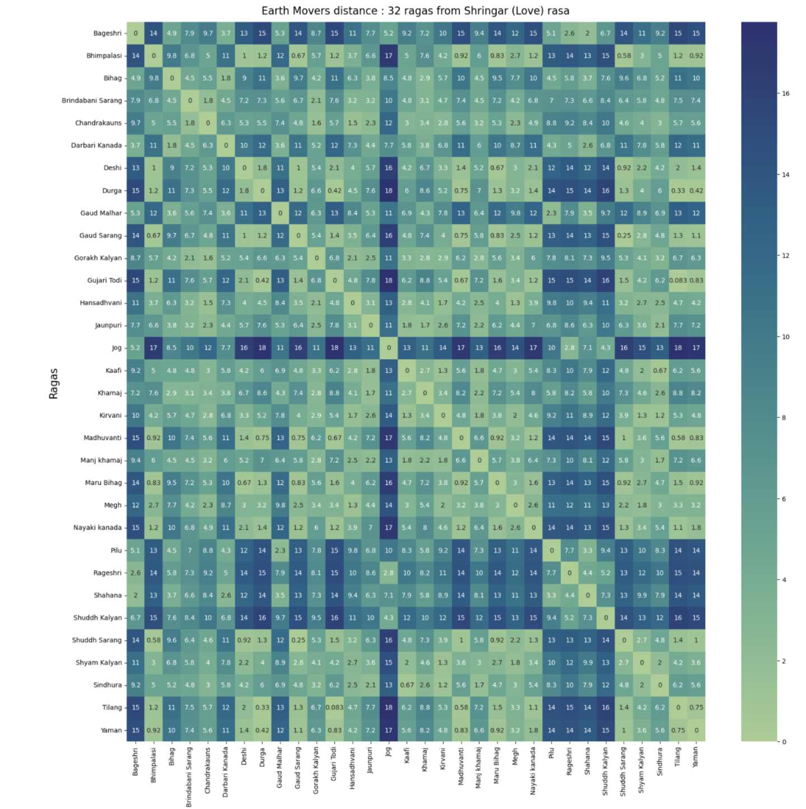
Shringar (Love)
Notes:
Jaijaivanti really dissimilar

Slide 15
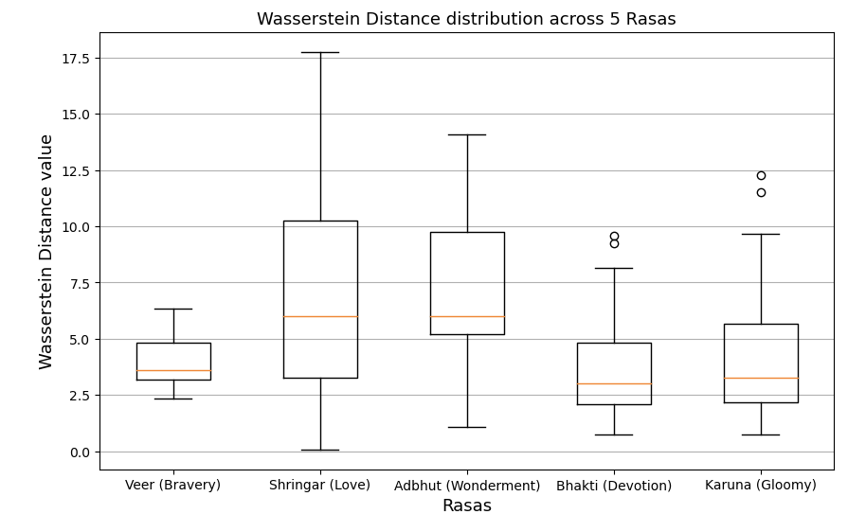
Inter-rasa comparison
N= 5
N= 32
N= 5
N= 13
N= 10
Rasas ->
Notes:
Difference in the number,

Slide 16
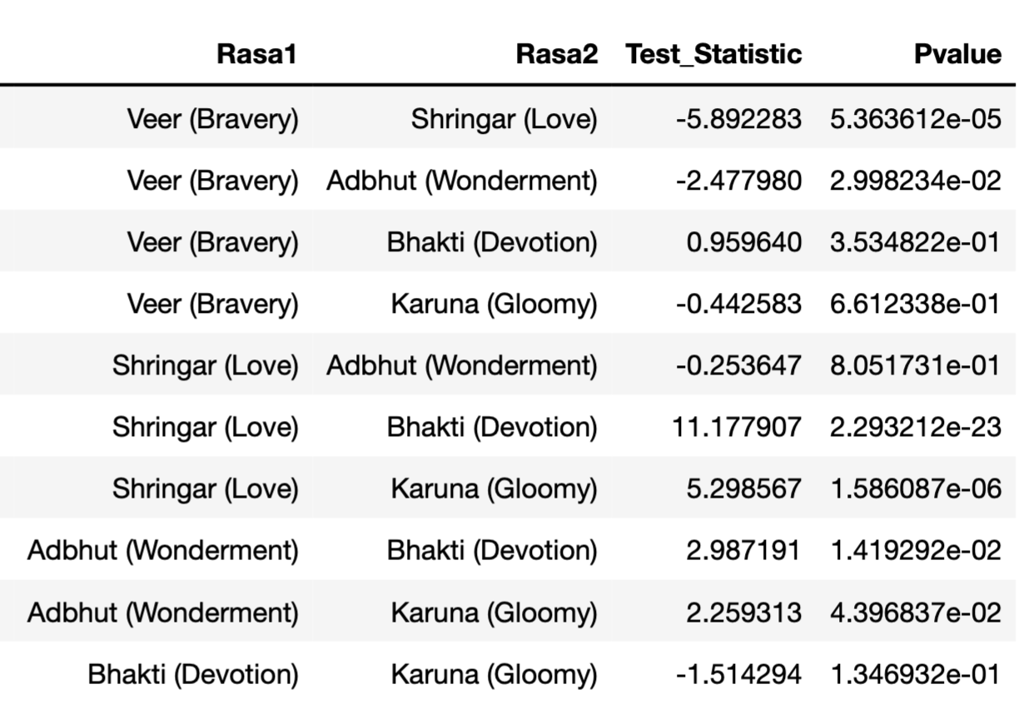
Inter-rasa comparison
Welsch T-Test
Notes:
We wanted to also see inter-rasa. Since the variances of each rasa are different. The reason of choosing Wttest,

Slide 17
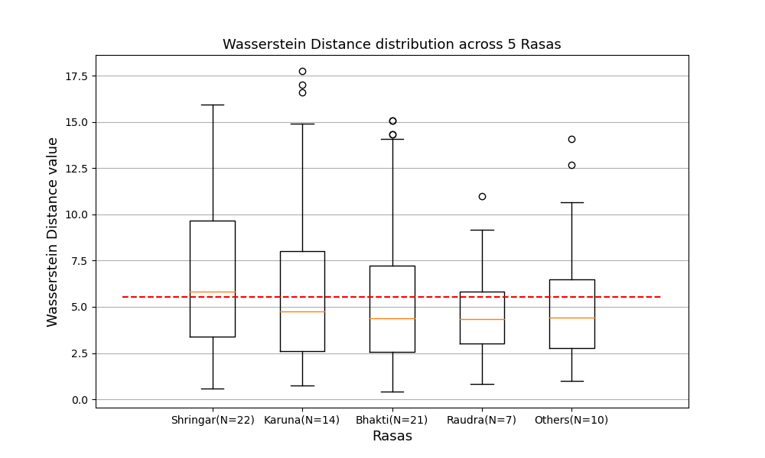
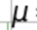
--- Mean pairwise WD across 100
random sampled groups of size 13.
= 5.67

Slide 18
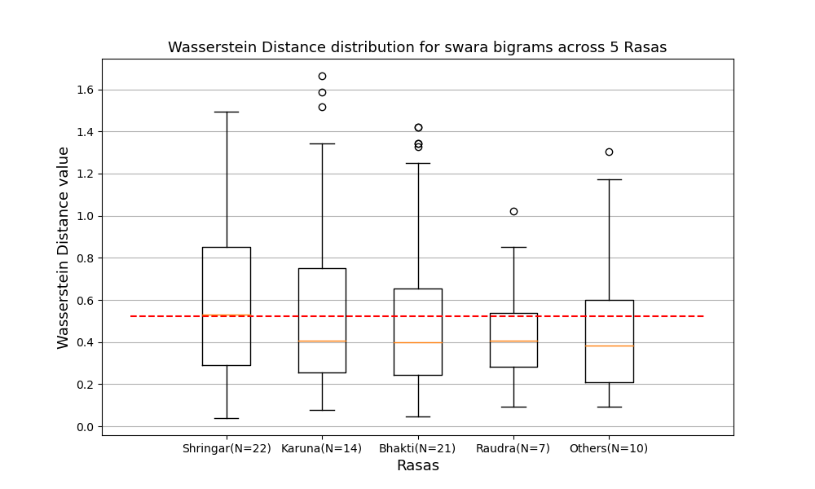
--- Mean pairwise WD across 100
random sampled groups of size 13.
=0.505

Slide 19
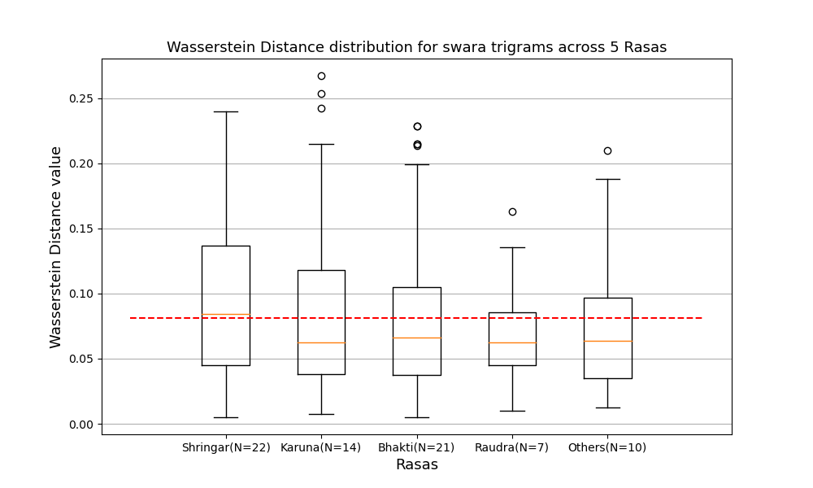
--- Mean pairwise WD across 100
random sampled groups of size 13.
= 0.081

Slide 20
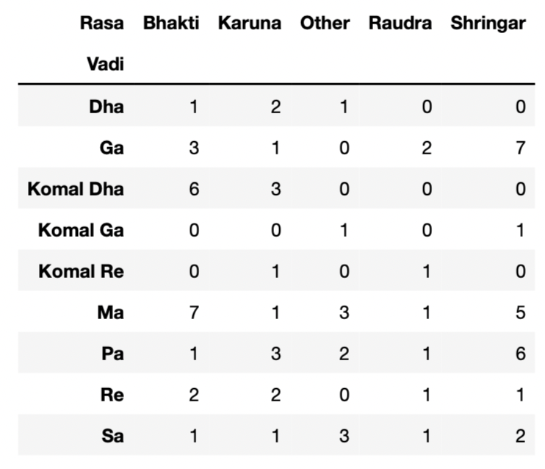
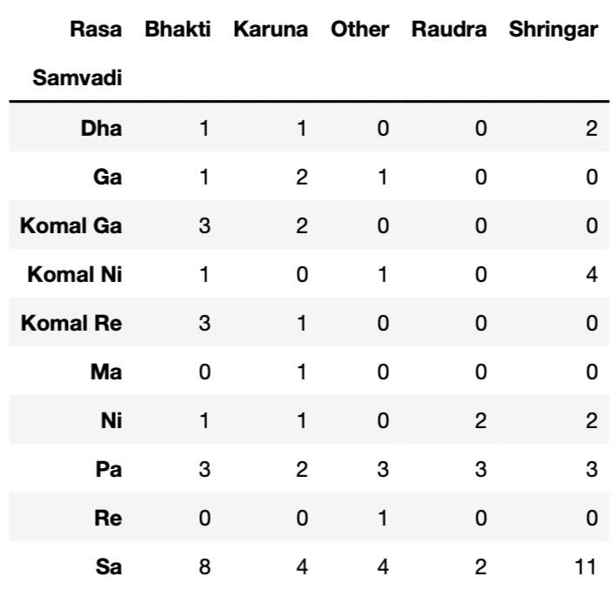

Slide 21
Remaining work (for this week!)
With this pipeline, compute 2/3 grams distances among ragas.
Compute the significance of each rasa by random sampling.
Try other metrics for distance?

Slide 22
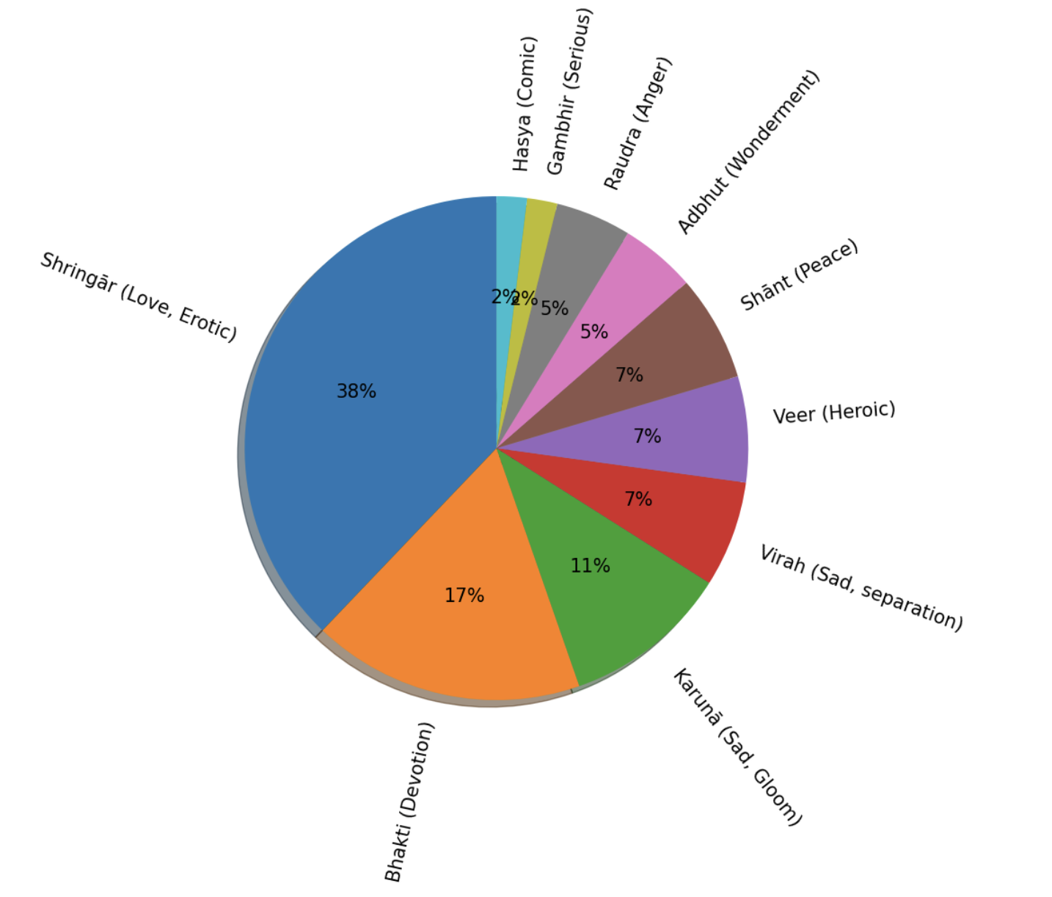
Dataset
The Raga Guide
manual transcriptions of the alāp (un-metered section) section
74 Hindustani ragas, across 4 artists
No information about rasa
Alāp
Bandish
Tān
un-metered exploration of the raga solfege and grammar
metered composition with lyrics
metered improvisation
Performance time
Notes:
Point out that our dataset contains only the Alaap

Slide 23
References
Agrawal, T., Shanahan, D., Huron, D., & Keller, H. (2021). Time-of-day practices echo circadian physiological arousal: An enculturated embodied practice in Hindustani classical music.
Manuel, P. (2001). The Raga Guide: A Survey of 74 Hindustani Ragas. Ethnomusicology, 45(3), 527.
**Bhatk humdrum representation: https://www.humdrum.org/rep/bhatk/index.html
Notes:
These are just our preliminary results, however, as the experiment is still ongoing.
Currently some of the features we want to analyze have not been included. For example,
-Additional symbolic features to analyze include harmony (in terms of information content as well as dissonance) and overall musical complexity. -We also plan to include additional audio features (prior research suggested spectral features such as spectral centroid & spectral flatness) "
So since this experiment is still ongoing, we don’t want to over-sell the results as ‘final’ in any case; however, that is what the preliminary analysis suggests.
Of course, we want to include many more musical factors. We simply began by trying to replicate predicting features that had been shown to work well with other musical styles (e.g., Classical); however, those were carried out on a much smaller scale (So in the case of Schubert, we looked at 4 classical works, some other papers use maybe 9 songs and sometimes the models were at the song level, so a model per song.)
So, in our case also, there are some features that are currently not present (that were there in some of these other models, for instance tempo) but we plan to add that.
And then we have additional features being calculated-
So, audio features being calculated (prior research suggested spectral features such as spectral centroid & spectral flatness)
Additional symbolic features to analyze include harmony (in terms of information content as well as dissonance) and overall musical complexity.

Slide 24

THANK YOU!

Slide 25
Caveats
The Alaap is very brief and might not be able to express the Rasa of the entire performance.
Operationalization of the term “melodic structure” does not incorporate ornamentations around notes.
Convenience sampling. Not enough samples.
Notes:
These are just our preliminary results, however, as the experiment is still ongoing.
Currently some of the features we want to analyze have not been included. For example,
-Additional symbolic features to analyze include harmony (in terms of information content as well as dissonance) and overall musical complexity. -We also plan to include additional audio features (prior research suggested spectral features such as spectral centroid & spectral flatness) "
So since this experiment is still ongoing, we don’t want to over-sell the results as ‘final’ in any case; however, that is what the preliminary analysis suggests.
Of course, we want to include many more musical factors. We simply began by trying to replicate predicting features that had been shown to work well with other musical styles (e.g., Classical); however, those were carried out on a much smaller scale (So in the case of Schubert, we looked at 4 classical works, some other papers use maybe 9 songs and sometimes the models were at the song level, so a model per song.)
So, in our case also, there are some features that are currently not present (that were there in some of these other models, for instance tempo) but we plan to add that.
And then we have additional features being calculated-
So, audio features being calculated (prior research suggested spectral features such as spectral centroid & spectral flatness)
Additional symbolic features to analyze include harmony (in terms of information content as well as dissonance) and overall musical complexity.

Slide 26
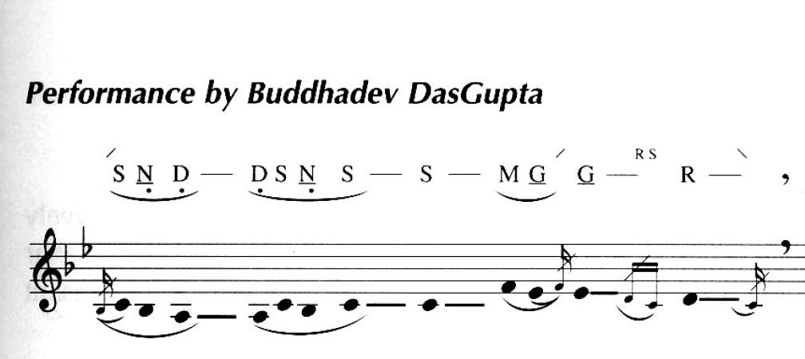
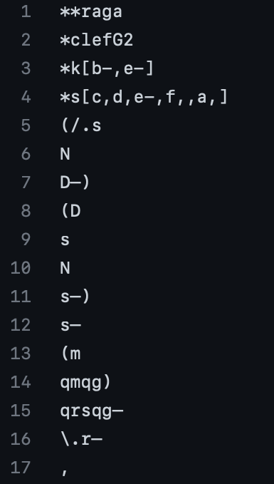
Sample corpus file
The RagaGuide notation (Manuel, P. 2001)
Humdrum Transcription (Agarwal et al, 2021)
Audio Performance
Hindustani swara: Sa Re Ga Ma Pa Dha Ni Western solfege: Do Re Mi Fa So La Ti

Slide 27
Sample corpus file
Humdrum representation
Scale
Melody represented in sargam solfege.
Octave: kern style
Ornaments
Meend: /. or \.
Note groups: ()
Hold the note: –
Kan or Grace/Murki or Mordent : qgqm
Melodic transcription
Phrase
ending
Humdrum Transcription
(Agarwal et al, 2021)
Notes:
Translation to Humdrum
Scale: noisy
Ornamentation: noisys

